Slide 1

SmartPik
PRASHANT CHAUHAN
E22CSEU0743

Slide 2

What is a Product
Recommendation System?
A product recommendation system is a type of filtering system that predicts and suggests items or products that a user might be interested in based on their preferences, past interactions, behavior, or other relevant data.
These systems are commonly used in e-commerce platforms, streaming services, social media platforms, and other online platforms to enhance user experience and increase engagement and sales.

Slide 3
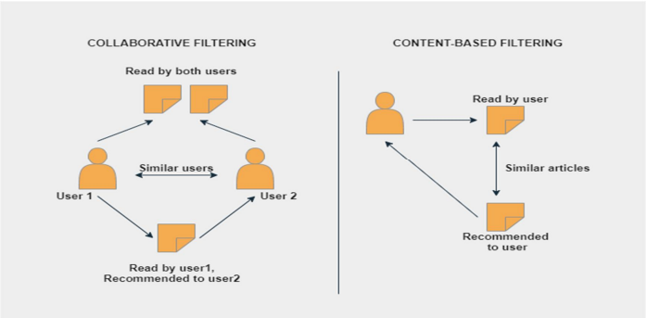
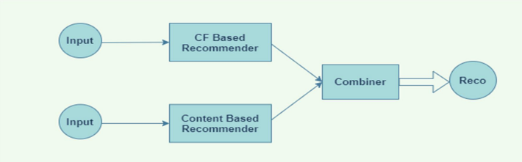
TECHNIQUES
CONTENT-BASED FILTERING
COLLABORATIVE FILTERING
HYBRID FILTERING

Slide 4

CHALLENGES FACED IN RECOMMENDATION SYSTEM
COLD START PROBLEM
SCALABILITY
DATA SPARSITY
LATENCY CHALLENGES
PRIVACY CONCERNS

Slide 5
HYBRID FILTERING
Hybrid filtering in recommender systems combines collaborative and content-based filtering techniques to provide more accurate and diverse recommendations. Collaborative filtering relies on user interactions to make recommendations, while content-based filtering uses item attributes or features. By integrating both approaches, hybrid filtering overcomes the limitations of individual methods and provides robust recommendations even in cases of new users or items and missing features.
Such approaches may be used to solve typical challenges, such as cold start or data paucity, in recommendation systems. Netflix's use of hybrid recommendation systems is a prime example. The website recommends comparing the viewing and browsing behaviors (i.e. collaborative filtering) of similar users as well as offering movies that share features with highly rated movies (content-based filtering).

Slide 6
Technique Used For Hybrid Filtering
In the project, a hybrid recommender system is created by integrating content-based filtering, utilizing TF-IDF vectorization and cosine similarity to compute item similarity based on content attributes such as product name, brand, category, color, and size, and collaborative filtering, employing the SVD (Singular Value Decomposition) algorithm for matrix factorization to personalize recommendations based on user behavior and preferences. This hybrid system evaluates the precision, recall, and mean average precision (MAP) to measure the quality of the recommendations. By combining both techniques, the recommendation system leverages the strengths of both content-based and collaborative filtering to deliver accurate and relevant item suggestions, catering to individual user preferences and enhancing the overall user experience.

Slide 7
Benefits of hybrid filtering
Hybrid filtering, combining collaborative and content-based filtering techniques, offers a robust solution to the challenges faced in recommendation systems, as demonstrated in this project. By integrating collaborative filtering, which leverages user interactions and preferences, with content-based filtering, which analyzes item attributes, our approach delivers recommendations that are both accurate and diverse.
Similar to the strategies employed by industry leaders such as Netflix, our hybrid method provides personalized recommendations tailored to individual users. Through the analysis of user interactions and item attributes, our approach effectively addresses challenges like the cold start problem, scalability issues, data sparsity, synonymy, latency challenges, and privacy concerns.
The flexibility of our hybrid approach allows us to optimize recommendation accuracy and relevance while ensuring efficient data usage and respecting user privacy preferences. Overall, our hybrid filtering method enhances the recommendation process, improving user experience and engagement.

Slide 8

Thank you
SmartPiker Team
E22CSEU0743@gmail.com

